Slide 1
QA

Slide 2

Sujata Batra - sujatabatra@hotmail.com
IT Trainer Since 2000
More than 50+ Corporate Clients

Slide 3
What is Testing
Testing is a group of techniques to determine the correctness of the application under the predefined script .
Testing cannot find all the defect of application.
Main intent of testing is to detect failures of the application so that failures can be discovered and corrected.
It does not demonstrate that a product functions properly under all conditions but only that it is not working in some specific conditions.

Slide 4
What is Testing
Testing furnishes comparison that compares the behavior and state of software against mechanisms.
The mechanism may include past versions of the same specified product, comparable products, and interfaces of expected purpose, relevant standards, or other criteria but not limited up to these.

Slide 5
What is Testing
Testing includes an examination of code and also the execution of code in various environments, conditions as well as all the examining aspects of the code.
In the current scenario of software development, a testing team may be separate from the development team so that Information derived from testing can be used to correct the process of software development.

Slide 6
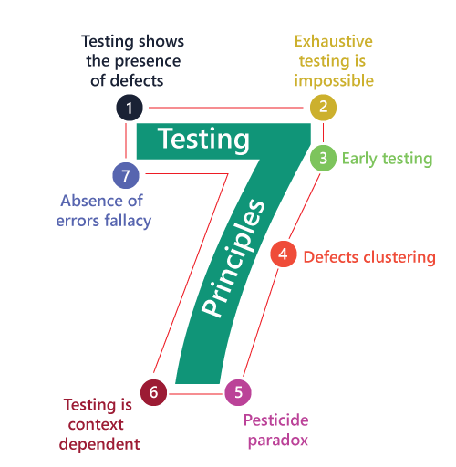
Software Testing Principles

Slide 7
1. Testing shows the presence of defects
The test engineer will test the application to make sure that the application is bug or defects free.
While doing testing, we can only identify that the application or software has any errors.
The primary purpose of doing testing is to identify the numbers of unknown bugs with the help of various methods and testing techniques because the entire test should be traceable to the customer requirement, which means that to find any defects that might cause the product failure to meet the client's needs.
By doing testing on any application, we can decrease the number of bugs, which does not mean that the application is defect-free because sometimes the software seems to be bug-free while performing multiple types of testing on it. But at the time of deployment in the production server, if the end-user encounters those bugs which are not found in the testing process.

Slide 8
2. Exhaustive Testing is not possible
Sometimes it seems to be very hard to test all the modules and their features with effective and non- effective combinations of the inputs data throughout the actual testing process.
Hence, instead of performing the exhaustive testing as it takes boundless determinations and most of the hard work is unsuccessful.
So we can complete this type of variations according to the importance of the modules because the product timelines will not permit us to perform such type of testing scenarios.

Slide 9
3. Early Testing
Testing activities should start in the early stages of the software development life cycle's requirement analysis stage to identify the defects because if we find the bugs at an early stage, it will be fixed in the initial stage itself, which may cost us very less as compared to those which are identified in the future phase of the testing process.
To perform testing, we will require the requirement specification documents; therefore, if the requirements are defined incorrectly, then it can be fixed directly rather than fixing them in another stage, which could be the development phase.

Slide 10
4. Defect clustering
Throughout the testing process, we can detect the numbers of bugs which are correlated to a small number of modules. We have various reasons for this, such as the modules could be complicated; the coding part may be complex, and so on.
These types of software or the application will follow the Pareto Principle, which states that we can identify that approx. Eighty percent of the complication is present in 20 percent of the modules. With the help of this, we can find the uncertain modules, but this method has its difficulties if the same tests are performing regularly, hence the same test will not able to identify the new defects.

Slide 11
5. Pesticide paradox
This principle defined that if we are executing the same set of test cases again and again over a particular time, then these kinds of the test will not be able to find the new bugs in the software or the application.
To get over these pesticide paradoxes, it is very significant to review all the test cases frequently.
New and different tests are necessary to be written for the implementation of multiple parts of the application or the software, which helps us to find more bugs.

Slide 12
6. Testing is context-dependent
We have multiple fields such as e-commerce websites, commercial websites, and so on are available in the market. There is a definite way to test the commercial site as well as the e-commerce websites because every application has its own needs, features, and functionality.
To check this type of application, we will take the help of various kinds of testing, different technique, approaches, and multiple methods.
Therefore, the testing depends on the context of the application.

Slide 13
7. Absence of errors fallacy
Once the application is completely tested and there are no bugs identified before the release, so we can say that the application is 99 percent bug-free. But there is the chance when the application is tested beside the incorrect requirements, identified the flaws, and fixed them on a given period would not help as testing is done on the wrong specification, which does not apply to the client's requirements.
The absence of error fallacy means identifying and fixing the bugs would not help if the application is impractical and not able to accomplish the client's requirements and needs.

Slide 14
SDLC
SDLC is a process that creates a structure of development of software.
It makes the development team able to design, create, and deliver a high-quality product.
SDLC describes various phases of software development and the order of execution of phases.
Each phase requires deliverable from the previous phase in a life cycle of software development.
Requirements are translated into design, design into development and development into testing; after testing, it is given to the client.

Slide 15
SDLC
Requirement Phase
Design Phase
Build /Development Phase
Testing Phase
Deployment/ Deliver Phase
Maintenance

Slide 16
1. Requirement Phase
During this phase, the client states requirements, specifications, expectations, and any other special requirement related to the product or software.
All these are gathered by the business manager or project manager or analyst of the service providing company.
The requirement includes how the product will be used and who will use the product to determine the load of operations.
All information gathered from this phase is critical to developing the product as per the customer requirements.

Slide 17
2. Design Phase
The design phase includes a detailed analysis of new software according to the requirement phase.
This is the high priority phase in the development life cycle of a system because the logical designing of the system is converted into physical designing.
The output of the requirement phase is a collection of things that are required, and the design phase gives the way to accomplish these requirements.
The decision of all required essential tools such as programming language like Java, .NET, PHP, a database like Oracle, MySQL, a combination of hardware and software to provide a platform on which software can run without any problem is taken in this phase.
There are several techniques and tools, such as data flow diagrams, flowcharts, decision tables, and decision trees, Data dictionary, and the structured dictionary are used for describing the system design.

Slide 18
3. Build /Development Phase
Next step is to implement the design into the development of a software system.
In this phase, work is divided into small units, and coding starts by the team of developers according to the design discussed in the previous phase and according to the requirements of the client discussed in requirement phase to produce the desired result.
Front-end developers develop easy and attractive GUI and necessary interfaces to interact with back-end operations and back-end developers do back-end coding according to the required operations. All is done according to the procedure and guidelines demonstrated by the project manager.
Since this is the coding phase, it takes the longest time and more focused approach for the developer in the software development life cycle.

Slide 19
4. Testing Phase
Testing is the last step of completing a software system.
In this phase, after getting the developed GUI and back-end combination, it is tested against the requirements stated in the requirement phase.
Testing determines whether the software is actually giving the result as per the requirements addressed in the requirement phase or not.
The Development team makes a test plan to start the test.
This test plan includes all types of essential testing such as integration testing, unit testing, acceptance testing, and system testing.
Non-functional testing is also done in this phase.
If there are any defects in the software or it is not working as per expectations, then the testing team gives information to the development team in detail about the issue.
If it is a valid defect or worth to sort out, it will be fixed, and the development team replaces it with the new one, and it also needs to be verified.

Slide 20
5. Deployment/ Deliver Phase
When software testing is completed with a satisfying result, and there are no remaining issues in the working of the software, it is delivered to the customer for their use.
As soon as customers receive the product, they are recommended first to do the beta testing.
In beta testing, customer can require any changes which are not present in the software but mentioned in the requirement document or any other GUI changes to make it more user-friendly.
Besides this, if any type of defect is encountered while a customer using the software; it will be informed to the development team of that particular software to sort out the problem.
If it is a severe issue, then the development team solves it in a short time; otherwise, if it is less severe, then it will wait for the next version.
After the solution of all types of bugs and changes, the software finally deployed to the end-user.

Slide 21
6. Maintenance
The maintenance phase is the last and long-lasting phase of SDLC because it is the process which continues until the software's life cycle comes to an end.
When a customer starts using software, then actual problems start to occur, and at that time there's a need to solve these problems. This phase also includes making changes in hardware and software to maintain its operational effectiveness like to improve its performance, enhance security features and according to customer's requirements with upcoming time. This process to take care of product time to time is called maintenance.

Slide 22
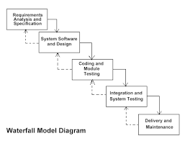
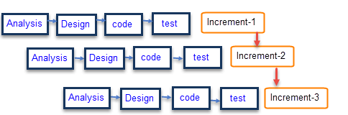
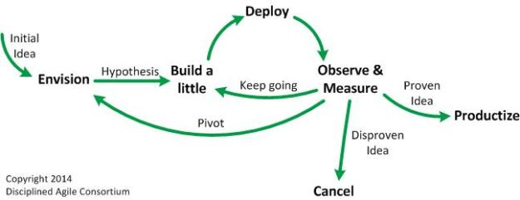
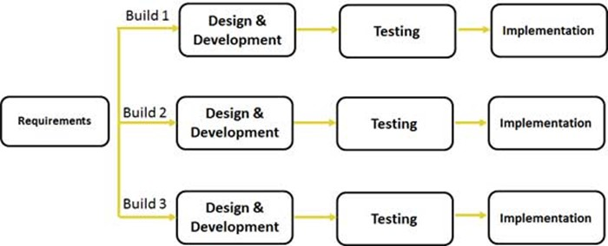
Types of SDLC
INCREMENTAL
WATERFALL
AGILE
ITERATIVE
Each kind of SDLC has its individual specificity tailored to situations where it may be necessitated.

Slide 23
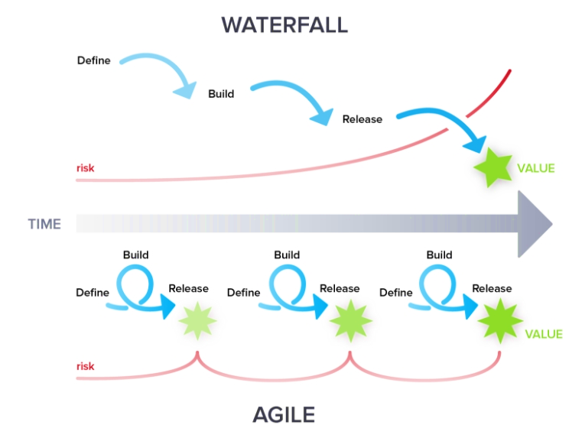
Waterfall Model
Sequential phase driven approach.
Focus on completing one step before moving to next step
Formal handover from one function to next
Delivery of overall functionality in single big bang

Slide 24
Waterfall Methodology (SDLC)
Requirement Elicitation
Requirement Analysis
Software Design
Coding
Testing
UAT
Deployment to Production
Post Production Maintenance

Slide 25

Strengths of Waterfall Model
Easy to understand, easy to use
Provides structure to inexperienced staff
Milestones are well understood
Sets requirements stability
Good for management control (plan, staff, track)
Works well when quality is more important
Than cost or schedule
Notes:
Easy to understand, easy to use
Provides structure to inexperienced staff
Milestones are well understood
Sets requirements stability
Good for management control (plan, staff, track)
Works well when quality is more important than cost or schedule

Slide 26
Weaknesses of Waterfall Model
All requirements must be known upfront
Deliverables created for each phase are considered frozen – inhibits flexibility
Can give a false impression of progress
Does not reflect problem-solving nature of software development – iterations of phases
Integration is one big bang at the end
Little opportunity for customer to preview the system (until it may be too late)
Notes:
All requirements must be known upfront
Deliverables created for each phase are considered frozen – inhibits flexibility
Can give a false impression of progress
Does not reflect problem-solving nature of software development – iterations of phases
Integration is one big bang at the end
Little opportunity for customer to preview the system (until it may be too late)

Slide 27
Adaptive or Agile Project Life Cycle
Less time is invested upfront for documenting requirements when development is done incrementally.
The agile model does not build an entire system at once.
Develops Incrementally
Unlike the more traditional waterfall approach, the agile development method is based on iterative and incremental development.
Notes:
(CLICK) Less time is invested upfront for documenting requirements when development is done incrementally.
(CLICK) In software development, the agile model does not build an entire system at once, but rather develops incrementally.
(CLICK) Unlike the more traditional waterfall approach, the agile development method is based on iterative and incremental development.

Slide 28

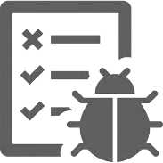



Adaptive or Agile Project Life Cycle
Requirements
Test and Feedback
Feedback
Feedback
Architecture and Design
Feedback
Feedback
Development
A mainline characteristic of agile software development is that customer feedback occurs simultaneously with development

Slide 29





Agile Ecosystem
Agile Ecosystem
Communication
Physical
Environment
Daily communication within and across the team using contemporary communication channels.
Common collaboration tool for the team.
Formal and efficient resolution process for blockages
Plan for frequent and timely travel between onshore-offshore.
Enough space in the work area for story boards, flip-charts and screens.
Face to Face setup
Meeting rooms within the project space with audio/video devices.
Robust server setups with high uptime to handle frequent deployment.
Uninterrupted connectivity with dedicated line to reduce downtime.
Increase the usage of tools for automation and avoiding time-delay due to manual intervention.
Agility is speed that’s what matters when you need
to reduce the speed to market!

Slide 30
Team Transformation
Agile
Project Management
Waterfall
Feature Team 1
(Plan, Analyze, Design, Build , QA)
Feature Team 2
(Plan, Analyze, Design, Build , QA)
Customer Involvement
Customer Involvement
Project Management
System Team
System Architecture Team
Development Team
(Analyze, Design, Build)
System Team
QA Team (Testing)
Scrums
Waterfall models gets trans mutated into Agile model as more and more traditional set ups are incorporating some or most of agile within themselves

Slide 31

Example of Agile Approach
Building a flyover on an extremely busy crossroad
This flyover project demonstrated how incremental delivery can indeed be extremely useful for the project as well as for the end customers.
The construction was planned to have incremental delivery, so that one direction of the flyover would be constructed before starting the work on the second direction
Notes:
An example is of building a flyover on an extremely busy crossroad.
This flyover project demonstrated how incremental delivery can indeed be extremely useful for the project as well as for the end customers.
The construction was planned to have incremental delivery, so that one direction of the flyover would be constructed before starting the work on the second direction

Slide 32

Example of Agile Approach
01
The overall traffic is still slow, but much better than without any flyovers.
02
Here the end customer (commuter) is using what we call a product of incremental delivery.
The one-way flyover construction is completed and opens for two-way traffic
03
This incremental delivery helped customers use the project (the flyover) in nine months instead of waiting twice that long (plus some inevitable delays).
Notes:
The one-way flyover construction is completed and opens for two-way traffic.
The overall traffic is still slow, but much better than without any flyovers.
Here the end customer (commuter) is using what we call a product of incremental delivery.
This incremental delivery helped customers use the project (the flyover) in nine months instead of waiting twice that long (plus some inevitable delays).

Slide 33

Agile Software Development
Agile development is a different way of managing IT development teams and projects.
The traditional approach to managing software development projects was failing far too often and there had to be a better way.
The agile manifesto describes 4 important values that are as relevant today as they were then.
It says,
“We value individuals and interactions over processes and tools
Working software over comprehensive documentation
customer collaboration over contract negotiation
responding to change over following a plan”.
Notes:
But exactly what is agile development?
Put simply, agile development is a different way of managing IT development teams and projects.
The use of the word agile in this context derives from the agile manifesto.
A small group of people got together in 2001 to discuss their feelings that the traditional approach to managing software development projects was failing far too often, and there had to be a better way.
They came up with the agile manifesto, which describes 4 important values that are as relevant today as they were then.
It says, “we value:
Individuals and interactions over processes and tools
Working software over comprehensive documentation
Customer collaboration over contract negotiation
Responding to change over following a plan

Slide 34
Agile Model - Advantages
Resource requirements are minimum
Delivery within an overall planned context
Realistic approach to software development
Good model for environments that change steadily
Gives flexibility to developers
Suitable for fixed or changing requirements
Little or no planning required
Promotes teamwork and cross training
Minimal rules, documentation easily employed
Delivers early partial working solutions
Easy to manage
Rapid functionality development
Enables concurrent development
Notes:
The advantages of the Agile Model are as follows −
Realistic approach to software development
Promotes teamwork and cross training
Functionality can be developed rapidly and demonstrated
Resource requirements are minimum
Suitable for fixed or changing requirements
Delivers early partial working solutions
Good model for environments that change steadily
Minimal rules, documentation easily employed
Enables concurrent development
Delivery within an overall planned context
Little or no planning required
Easy to manage
Gives flexibility to developers

Slide 35
Agile Model - Disadvantages
1
Not suitable for handling complex dependencies.
More risk of sustainability, maintainability and extensibility.
2
3
Overall plan is a must.
Strict delivery management to meet deadlines.
4
5
Depends heavily on customer interaction.
Very high individual dependency.
6
7
Technology transfer is challenging.
Lack of documentation.
8
Notes:
The disadvantages of the Agile Model are as follows −
Not suitable for handling complex dependencies
More risk of sustainability, maintainability and extensibility
An overall plan, an agile leader and agile project manager practice is a must without which the agile model will not work
Strict delivery management dictates the scope, functionality to be delivered, and adjustments to meet the deadlines
Depends heavily on customer interaction. If the customer is not clear, the team can be driven in the wrong direction.
There is a very high individual dependency, since there is minimum documentation generated.
Transfer of technology to new team members may be quite challenging due to lack of documentation.

Slide 36
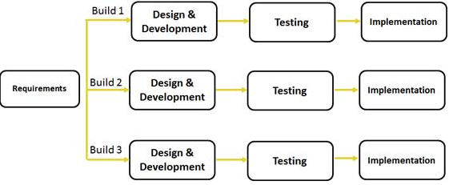
Iterative or Incremental Project Life Cycle
In an iterative model, the iterative process starts with a simple implementation of a small set of software requirements and iteratively enhances the evolving versions. This cycle is repeated until the complete system is implemented and ready to be deployed.
Notes:
In an iterative model, the iterative process starts with a simple implementation of a small set of software requirements and iteratively enhances the evolving versions. This cycle is repeated until the complete system is implemented and ready to be deployed.

Slide 37
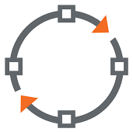

Introduction to Iterative Project Life Cycle
An iterative life cycle model does not attempt to start with a full specification of requirements.
Development begins by specifying and implementing just part of the software, which can then be reviewed in order to identify further requirements.
This process is then repeated, producing a new version of the
software for each cycle of the model.
Notes:
An iterative life cycle model does not attempt to start with a full specification of requirements.
Instead, development begins by specifying and implementing just part of the software, which can then be reviewed in order to identify further requirements.
This process is then repeated, producing a new version of the software for each cycle of the model.

Slide 38
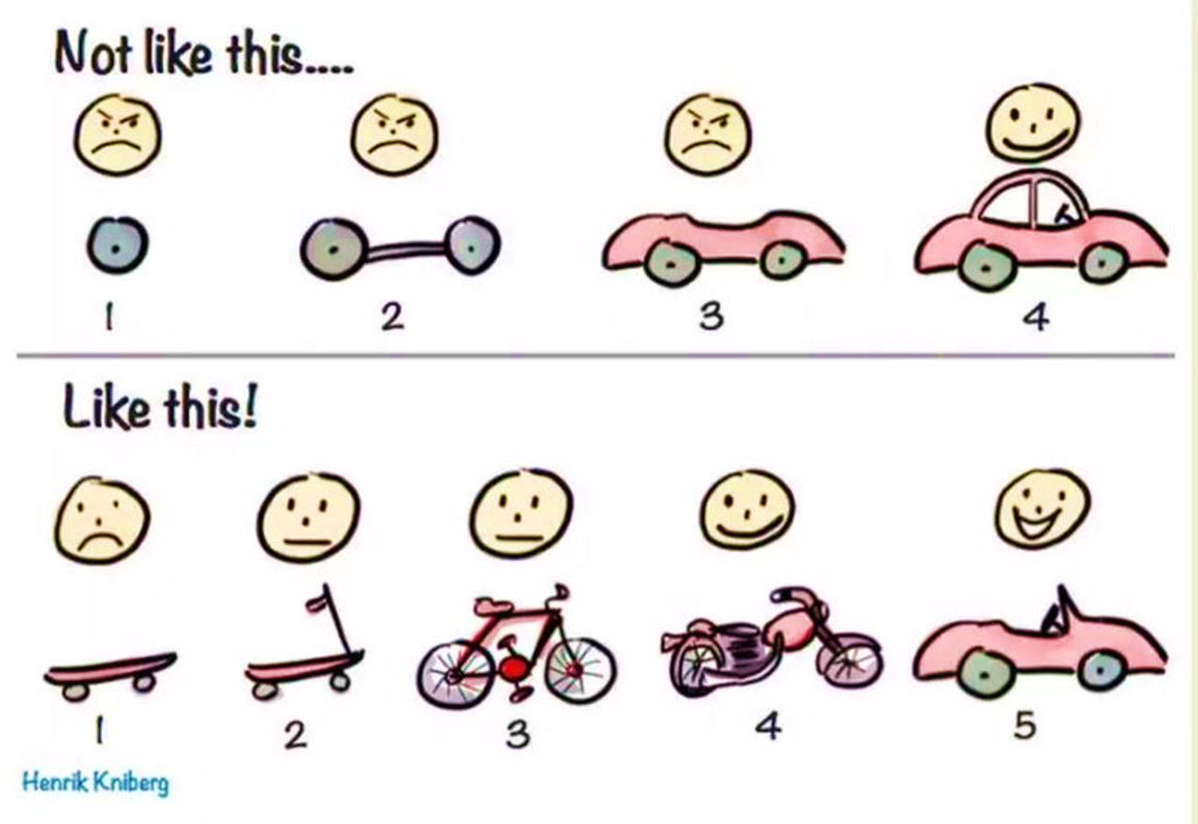
Iterative Model
Iterative work creates a rough product or piece in one iteration. This product or piece is then reviewed and will be improve it in next iteration and so on until it’s finished.
Hence, in an iterative model the whole product is developed step by step.
Notes:
In the diagram you can see how the bike is formed one single board with wheels, in the same way when we work iteratively we create a rough product or piece in one iteration, then review it and improve it in next iteration and so on until it’s finished.
Hence, in iterative model the whole product is developed step by step.

Slide 39

Iterative Model Application
Requirements of the complete system are clearly defined and understood.
Major requirements must be defined; however, some functionalities or requested enhancements may evolve with time.
There is a time to the market constraint.

Slide 40
Iterative Model Application
A new technology is being used and is being learnt by the development team while working on the project.
Resources with needed skill set are not available and are planned to be used on contract basis for specific iterations.
There are some high risk features and goals which may change in the future.
As the model name suggests, the evolution takes its time and pace as acceptable to project!

Slide 41

Iterative Model - Advantages
01
An iterative model creates a high-level design of the application before building the product and defining the design solution for the entire product.
02
Later, design and built a skeleton version, and then evolve the design based on what had been built.
03
An iterative model builds and improves the product step by step.
04
Hence, defects can be tracked at early stages.
Notes:
Advantages of Iterative model:
An iterative model creates a high-level design of the application before building the product and defining the design solution for the entire product.
Later, design and built a skeleton version, and then evolve the design based on what had been built.
An iterative model builds and improves the product step by step. Hence, defects can be tracked at early stages.

Slide 42
Iterative Model - Advantages
05
This avoids the downward flow of the defects. Testing and debugging during smaller iteration is easy.
Reliable user feedback is possible. Risks are identified and resolved during iteration; and each iteration is an easily managed milestone.
06
07
When presenting sketches and blueprints of the product to users for their feedback, users imagine how the product will work.
08
In an iterative model lesser time is spent on documenting and more time is given for designing.
Notes:
This avoids the downward flow of the defects. Testing and debugging during smaller iteration is easy.
Reliable user feedback is possible. Risks are identified and resolved during iteration; and each iteration is an easily managed milestone.
When presenting sketches and blueprints of the product to users for their feedback, users imagine how the product will work.
In an iterative model lesser time is spent on documenting and more time is given for designing.

Slide 43
Iterative Model - Disadvantages
Applicable only to large and bulky software development projects.
Hard to break a small software system into further small serviceable increments/modules.
More resources may be required.
Although cost of change is lesser but it is not very suitable for changing requirements.
Notes:
The disadvantage with this model is that it is applicable only to large and bulky software development projects.
This is because it is hard to break a small software system into further small serviceable increments/modules.
More resources may be required.
Although cost of change is lesser but it is not very suitable for changing requirements.

Slide 44
Iterative Model - Disadvantages
More management attention is required.
System architecture or design issues may arise because not all requirements are gathered in the beginning
of the entire life cycle.
Defining increments may require definition of the complete system
Not suitable for smaller projects
Notes:
More management attention is required.
System architecture or design issues may arise because not all requirements are gathered in the beginning of the entire life cycle.
Defining increments may require definition of the complete system
Not suitable for smaller projects

Slide 45

Incremental Model
The whole requirement is divided into various builds.
Multiple development cycles take place here, making the life cycle a “multi-waterfall” cycle.
Module 1
Module 3
Module 2
Cycles are divided up into smaller, more easily managed modules.
Incremental model is a type of software development model like V-model, Agile model etc.
Notes:
In incremental model the whole requirement is divided into various builds.
Multiple development cycles take place here, making the life cycle a “multi-waterfall” cycle.
Cycles are divided up into smaller, more easily managed modules.
Incremental model is a type of software development model like V-model, Agile model etc.

Slide 46


Incremental Model
Each module passes through the requirements, design, implementation and testing phases.
A working version of software is produced during the first module, so you have working software early on during the software life cycle.
Each subsequent release of the module adds function to the previous release.
The process continues till the complete system is achieved.
2
Notes:
In this model, each module passes through the requirements, design, implementation and testing phases.
A working version of software is produced during the first module, so you have working software early on during the software life cycle.
Each subsequent release of the module adds function to the previous release.
The process continues till the complete system is achieved.

Slide 47


Incremental Model
When we work incrementally we add piece by piece but
expect that each piece is fully finished.
For example:
As in the image above:
01
02
03
04
The first iteration the first module of the application or product is ready and can be demoed to the customers.
A person has thought of the application
The other module is ready and integrated with the first module
The whole product is ready and integrated.
Hence, the product got ready step by step.
Notes:
In the diagram above when we work incrementally we are adding piece by piece but expect that each piece is fully finished.
Thus keep on adding the pieces until it’s complete.
As in the example
A person has thought of the application. The first iteration the first module of the application or product is ready and can be demoed to the customers. Likewise, in the second iteration the other module is ready and integrated with the first module. Similarly, in the third iteration the whole product is ready and integrated. Hence, the product got ready step by step.

Slide 48
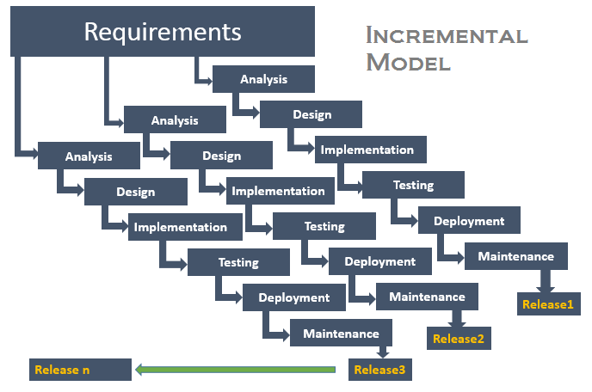
Incremental Model Applications
The Incremental model is an evolution of the Waterfall model,
where the Waterfall model is incrementally applied.
Notes:
When to use the Incremental model:
This model can be used when the requirements of the complete system are clearly defined and understood.
Major requirements must be defined; however, some details can evolve with time.
There is a need to get a product to the market early.
A new technology is being used
Resources with needed skill set are not available
There are some high risk features and goals.

Slide 49

Incremental Model- Advantages
Generates working software quickly and early during the software life cycle.
01
This model is more flexible – less costly to change scope and requirements.
02
It is easier to test and debug during a smaller iteration.
03
In this model customer can respond to each built.
04
Lowers initial delivery cost.
05
Easier to manage risk because risky pieces are identified and handled during it’d iteration.
06
Notes:
Advantages of Incremental model:
Generates working software quickly and early during the software life cycle.
This model is more flexible – less costly to change scope and requirements.
It is easier to test and debug during a smaller iteration.
In this model customer can respond to each built.
Lowers initial delivery cost.
Easier to manage risk because risky pieces are identified and handled during it’d iteration.

Slide 50



Incremental Model- Disadvantages
Needs a clear and complete definition of the whole system before it can be broken down and built incrementally.
Total cost is higher than waterfall.
Needs good planning and design.
Notes:
Disadvantages of Incremental model:
Needs good planning and design.
Needs a clear and complete definition of the whole system before it can be broken down and built incrementally.
Total cost is higher than waterfall.

Slide 51

Key Highlights
Under the Incremental Model, software requirements are initially broken down into multiple standalone modules.
These modules are drafted according to the level of priority they have under the software project.
Every module is a standalone function
Notes:
Under Incremental Model, software requirements are initially broken down into multiple standalone modules.
These modules are drafted according to the level of priority they have under the software project. Here every module is a standalone function

Slide 52
Key Highlights
Each module has to be developed according to the implementation and progression of the project.
Although they can be inter-related they can exist without having the need of other modules and functionality.
Incremental model is mostly followed by large projects that require implementing individual functions and adding standalone models in the long run.
Mostly followed by large projects
A customized step-by-step approach
generally adopts an incremental approach.
Notes:
and has to be developed according to the implementation and progression of the project.
Although they can be inter-related they can exist without having the need of other modules and functionality.
Incremental model is mostly followed by large projects that require implementing individual functions and adding standalone models in the long run.

Slide 53
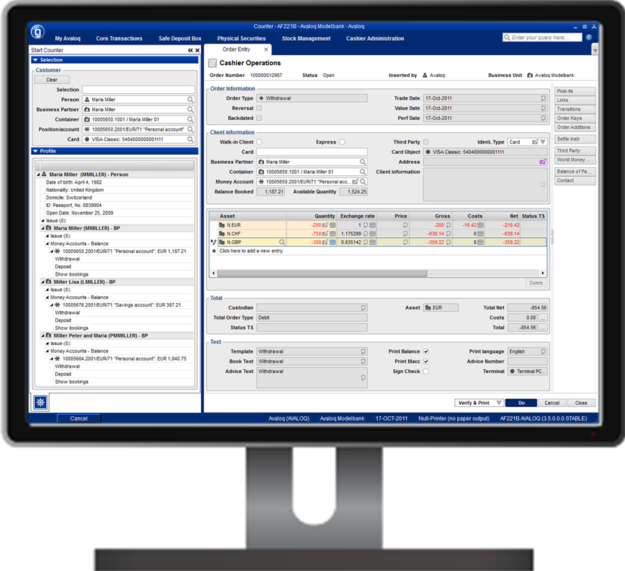


Example of Incremental Model
To enhance the customer services
A bank wants to develop software to automate the banking process for insurance services, personal banking, and home and automobile loans.
Notes:
Consider an example where a bank wants to develop software to automate the banking process for insurance services, personal banking, and home and automobile loans.
The bank wants the automation of personal banking system immediately because it will enhance the customer services.

Slide 54
Example of Incremental Model
1st Increment
You can implement the personal banking feature and deliver it to the customer.
Later Increments
you can implement the insurance services, home loans, and automobile loans features of the bank.
You can implement the incremental approach to develop the banking software.
Notes:
You can implement the incremental approach to develop the banking software. In the first increment, you can implement the personal banking feature and deliver it to the customer.
In the later increments, you can implement the insurance services, home loans, and automobile loans features of the bank.

Slide 55
Software Testing Life Cycle
Software testing life cycle contains the following steps:
Requirement Analysis
Test Plan Creation
Environment setup
Test case Execution
Defect Logging
Test Cycle Closure

Slide 56
1. Requirement Analysis:
Tester analyses requirement document of SDLC (Software Development Life Cycle) to examine requirements stated by the client.
After examining the requirements, the tester makes a test plan to check whether the software is meeting the requirements or not.
Entry Criteria | Activities | Deliverable
For the planning of test plan requirement specification, application architecture document and well-defined acceptance criteria should be available. | Prepare the list of all requirements and queries, and get resolved from Technical Manager/Lead, System Architecture, Business Analyst and Client. Make a list of all types of tests (Performance, Functional and security) to be performed. Make a list of test environment details, which should contain all the necessary tools to execute test cases. | List of all the necessary tests for the testable requirements and Test environment details

Slide 57
2. Test Plan Creation:
Tester determines the estimated effort and cost of the entire project. This phase takes place after the successful completion of the Requirement Analysis Phase.
Testing strategy and effort estimation documents provided by this phase.
Test case execution can be started after the successful completion of Test Plan Creation.
Entry Criteria | Activities | Deliverable
Requirement Document | Define Objective as well as the scope of the software. List down methods involved in testing. Overview of the testing process. Settlement of testing environment. Preparation of the test schedules and control procedures. Determination of roles and responsibilities. List down testing deliverables, define risk if any. | Test strategy document. Testing Effort estimation documents are the deliverables of this phase.

Slide 58
3. Environment setup:
Setup of the test environment is an independent activity and can be started along with Test Case Development.
This is an essential part of the manual testing procedure as without environment testing is not possible.
Environment setup requires a group of essential software and hardware to create a test environment.
The testing team is not involved in setting up the testing environment, its senior developers who create it.
Entry Criteria | Activities | Deliverable
Test strategy and test plan document. Test case document. Testing data. | Prepare the list of software and hardware by analyzing requirement specification. After the setup of the test environment, execute the smoke test cases to check the readiness of the test environment. | Execution report. Defect report.

Slide 59
4. Test case Execution:
Testing team starts case development and execution activity.
The testing team writes down the detailed test cases, also prepares the test data if required.
The prepared test cases are reviewed by peer members of the team or Quality Assurance leader.
RTM (Requirement Traceability Matrix) is also prepared in this phase.
Requirement Traceability Matrix is industry level format, used for tracking requirements.
Each test case is mapped with the requirement specification.
Backward & forward traceability can be done via RTM.
Entry Criteria | Activities | Deliverable
Requirement Document | Creation of test cases. Execution of test cases. Mapping of test cases according to requirements. | Test execution result. List of functions with the detailed explanation of defects.

Slide 60
5. Defect Logging:
This phase determines the characteristics and drawbacks of the software.
Test cases and bug reports are analyzed in depth to detect the type of defect and its severity.
Defect logging analysis mainly works to find out defect distribution depending upon severity and types.
If any defect is detected, then the software is returned to the development team to fix the defect, then the software is re-tested on all aspects of the testing.
Entry Criteria | Activities | Deliverable
Test case execution report. Defect report | It evaluates the completion criteria of the software based on test coverage, quality, time consumption, cost, and critical business objectives. Defect logging analysis finds out defect distribution by categorizing in types and severity. | Closure report Test metrics

Slide 61
6. Test Cycle Closure:
The test cycle closure report includes all the documentation related to software design, development, testing results, and defect reports.
The test cycle closure report includes all the documentation related to software design, development, testing results, and defect reports.
Entry Criteria | Activities | Deliverable
All document and reports related to software. | Evaluates the strategy of development, testing procedure, possible defects to use these practices in the future if there is a software with the same specification | Test closure report

Slide 62
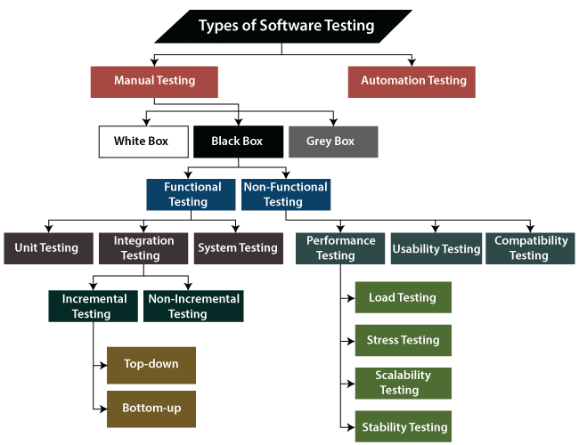
Types of Software Testing

Slide 63
What is Manual Testing?
Testing any software or an application according to the client's needs without using any automation tool is known as manual testing.
In software testing, manual testing can be further classified into three different types of testing:
White Box Testing
Black Box Testing
Grey Box Testing

Slide 64
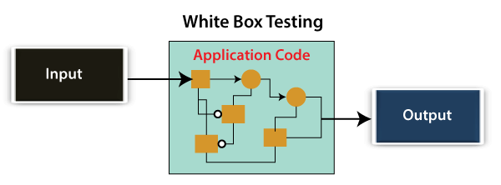
White Box Testing
Developer will execute the complete white-box testing for the particular software and send the specific application to the testing team.
The purpose of implementing the white box testing is to emphasize the flow of inputs and outputs over the software and enhance the security of an application.
White box testing is also known as open box testing, glass box testing, structural testing, clear box testing, and transparent box testing.

Slide 65
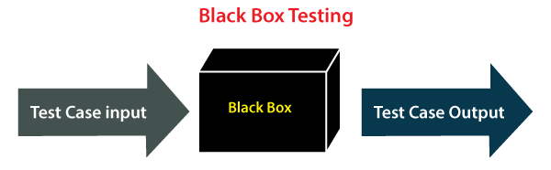
Black Box Testing
Test engineer will analyze the software against requirements, identify the defects or bug, and sends it back to the development team.
Developers will fix those defects, do one round of White box testing, and send it to the testing team.
The main objective of implementing the black box testing is to specify the business needs or the customer's requirements.
It is a process of checking the functionality of an application as per the customer requirement. The source code is not visible in this testing; that's why it is known as black-box testing.

Slide 66
Types of Black Box Testing
Black box testing further categorizes into two parts:
Functional Testing
Non-function Testing

Slide 67
Functional Testing
The test engineer will check all the components systematically against requirement specifications is known as functional testing. Functional testing is also known as Component testing.
In functional testing, all the components are tested by giving the value, defining the output, and validating the actual output with the expected value.
Functional testing is a part of black-box testing as its emphases on application requirement rather than actual code. The test engineer has to test only the program instead of the system.
Types of Functional Testing:
Unit Testing
Integration Testing
System Testing

Slide 68
1. Unit Testing
Unit testing is the first level of functional testing in order to test any software.
In this, the test engineer will test the module of an application independently or test all the module functionality is called unit testing.
The primary objective of executing the unit testing is to confirm the unit components with their performance.
Unit is defined as a single testable function of a software or an application.
Verified throughout the specified application development phase.

Slide 69
2. Integration Testing
It is the second level of functional testing, test the data flow between dependent modules or interface between two features is called integration testing.
The purpose of executing the integration testing is to test the statement's accuracy between each module.
Types of Integration Testing
Incremental Testing
Non-Incremental Testing

Slide 70
Incremental Integration Testing
Whenever there is a clear relationship between modules, we go for incremental integration testing.
Suppose, we take two modules and analysis the data flow between them if they are working fine or not.
If these modules are working fine, then we can add one more module and test again.
We can continue with the same process to get better results.
Types of Incremental Integration Testing
Top-down Incremental Integration Testing
Add the modules step by step or incrementally and test the data flow between them.
Ensure that the modules we are adding are the child of the earlier ones.
Bottom-up Incremental Integration Testing
Add the modules incrementally and check the data flow between modules.
Ensure that the module we are adding is the parent of the earlier ones.

Slide 71
Non-Incremental Integration Testing/ Big Bang Method
Whenever the data flow is complex and very difficult to classify a parent and a child, go for the non-incremental integration approach.

Slide 72
3. System Testing
Whenever we are done with the unit and integration testing, we can proceed with the system testing.
In system testing, the test environment is parallel to the production environment.
It is also known as end-to-end testing.
In this type of testing, we will undergo each attribute of the software and test if the end feature works according to the business requirement.
Analysis the software product as a complete system.

Slide 73
Non-function Testing
Provides detailed information on software product performance and used technologies.
Non-functional testing will help us minimize the risk of production and related costs of the software.
Non-functional testing is a combination of performance, load, stress, usability and, compatibility testing.
Types of Non-functional Testing
Performance Testing
Usability Testing
Compatibility Testing

Slide 74
1. Performance Testing
Test engineer will test the working of an application by applying some load.
Test engineer will only focus on several aspects, such as Response time, Load, scalability, and Stability of the software or an application.

Slide 75
Classification of Performance Testing
Load Testing
Apply some load on the particular application to check the application's performance, known as load testing.
Load could be less than or equal to the desired load.
It will help us to detect the highest operating volume of the software and bottlenecks.
Stress Testing
Used to analyze the user-friendliness and robustness of the software beyond the common functional limits.
Primarily, stress testing is used for critical software, but it can also be used for all types of software applications.
Scalability Testing
Analysis the application's performance by enhancing or reducing the load in particular balances is known as scalability testing.
In scalability testing, we can also check the system, processes, or database's ability to meet an upward need.
Stability Testing
Stability testing is a procedure where we evaluate the application's performance by applying the load for a precise time.
Mainly checks the constancy problems of the application and the efficiency of a developed product. In this type of testing, we can rapidly find the system's defect even in a stressful situation.

Slide 76
Grey Box Testing
Is a collaboration of black box and white box testing.
Includes access to internal coding for designing test cases.
Performed by a person who knows coding as well as testing.

Slide 77
Testing Documentation
Testing documentation is the documentation of artifacts that are created during or before the testing of a software application.
Documentation reflects the importance of processes for the customer, individual and organization.
Projects which contain all documents have a high level of maturity.
Careful documentation can save the time, efforts and wealth of the organization.

Slide 78
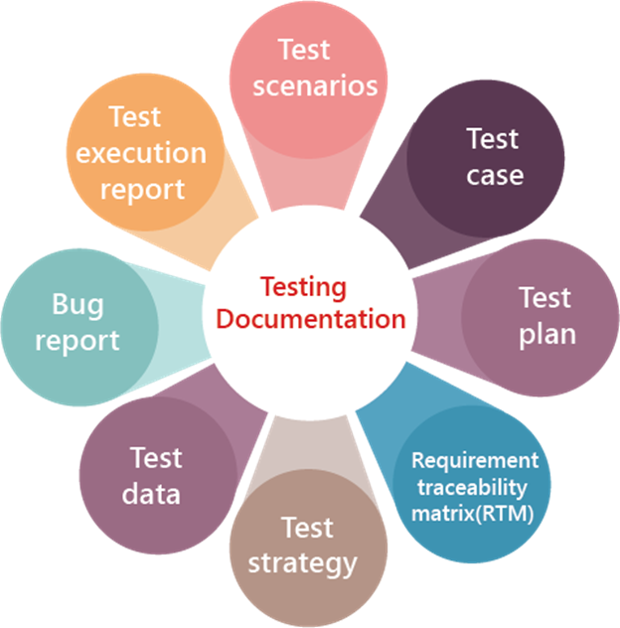
Types of test document
Test scenarios
Test case
Test plan
Requirement traceability matrix(RTM)
Test strategy
Test data
Bug report
Test execution report

Slide 79
Test Scenarios
It is a document that defines the multiple ways or combinations of testing the application.
It is prepared to understand the flow of an application. It does not consist of any inputs and navigation steps.

Slide 80
Test case
It is an in-details document that describes step by step procedure to test an application.
It consists of the complete navigation steps and inputs and all the scenarios that need to be tested for the application.
We will write the test case to maintain the consistency, or every tester will follow the same approach for organizing the test document.

Slide 81
Test Plan
It is a document that is prepared by the managers or test lead. It consists of all information about the testing activities.
The test plan consists of multiple components such as Objectives, Scope, Approach, Test Environments, Test methodology, Template, Role & Responsibility, Effort estimation, Entry and Exit criteria, Schedule, Tools, Defect tracking, Test Deliverable, Assumption, Risk, and Mitigation Plan or Contingency Plan.

Slide 82
Requirement Traceability Matrix (RTM)
The Requirement traceability matrix [RTM] is a document which ensures that all the test case has been covered.
This document is created before the test execution process to verify that we did not miss writing any test case for the particular requirement.

Slide 83
Test strategy
The test strategy is a high-level document, which is used to verify the test types (levels) to be executed for the product and also describe that what kind of technique has to be used and which module is going to be tested.
The Project Manager can approve it.
It includes the multiple components such as documentation formats, objective, test processes, scope, and customer communication strategy, etc. we cannot modify the test strategy.

Slide 84
Test Data
It is data that occurs before the test is executed. It is mainly used when we are implementing the test case. Mostly, we will have the test data in the Excel sheet format and entered manually while performing the test case.
The test data can be used to check the expected result, which means that when the test data is entered, the expected outcome will meet the actual result and also check the application performance by entering the in-correct input data.

Slide 85
Bug report
The bug report is a document where we maintain a summary of all the bugs which occurred during the testing process.
This is a crucial document for both the developers and test engineers because, with the help of bug reports, they can easily track the defects, report the bug, change the status of bugs which are fixed successfully, and also avoid their repetition in further process.

Slide 86
Test execution report
It is the document prepared by test leads after the entire testing execution process is completed.
The test summary report defines the constancy of the product, and it contains information like the modules, the number of written test cases, executed, pass, fail, and their percentage.
Each module has a separate spreadsheet of their respective module.

Slide 87
Benefits of using Documentation
Documentation clarifies the quality of methods and objectives.
It ensures internal coordination when a customer uses software application.
It ensures clarity about the stability of tasks and performance.
It provides feedback on preventive tasks.
It provides feedback for your planning cycle.
It creates objective evidence for the performance of the quality management system.
If we write the test document, we can't forget the values which we put in the first phase.
It is also a time-saving process because we can easily refer to the text document.
It is also consistent because we will test on the same value.

Slide 88
Drawback of the test document
It is a bit tedious because we have to maintain the modification provided by the customer and parallel change in the document.
If the test documentation is not proper, it will replicate the quality of the application.
Sometimes it is written by that person who does not have the product knowledge.
Sometimes the cost of the document will be exceeding its value.

Slide 89
Test Scenarios
Is a detailed document of test cases that cover end to end functionality of a software application in liner statements.
High-level classification of testable requirements.
Requirements are grouped on the basis of the functionality of a module and obtained from the use cases.
In the test scenario, there is a detailed testing process due to many associated test cases.
Before performing the test scenario, the tester has to consider the test cases for each scenario.
In the test scenario, testers need to put themselves in the place of the user because they test the software application under the user's point of view.
Preparation of scenarios is the most critical part, and it is necessary to seek advice or help from customers, stakeholders or developers to prepare the scenario.
Note:
The test scenarios can never be used for the text execution process because it does not consist of navigation steps and input.
These are the high-level documents that talks about all the possible combination or multiple ways or combinations of using the application and the primary purpose of the test scenarios are to understand the overall flow of the application.

Slide 90
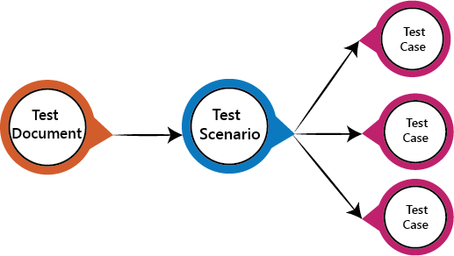
Test Scenario

Slide 91
How to write Test Scenarios
Read the requirement document such as BRS (Business Requirement Specification), SRS (System Requirement Specification) and FRS (Functional Requirement Specification) of the software which is under the test.
Determine all technical aspects and objectives for each requirement.
Find all the possible ways by which the user can operate the software.
Ascertain all the possible scenario due to which system can be misused and also detect the users who can be hackers.
After reading the requirement document and completion of the scheduled analysis make a list of various test scenarios to verify each function of the software.
Once you listed all the possible test scenarios, create a traceability matrix to find out whether each and every requirement has a corresponding test scenario or not.
Supervisor of the project reviews all scenarios. Later, they are evaluated by other stakeholders of the project.

Slide 92
Features of Test Scenario
The test scenario is a liner statement that guides testers for the testing sequence.
Test scenario reduces the complexity and repetition of the product.
Test scenario means talking and thinking about tests in detail but write them in liner statements.
It is a thread of operations.
Test scenario becomes more important when the tester does not have enough time to write test cases, and team members agree with a detailed liner scenario.
The test scenario is a time saver activity.
It provides easy maintenance because the addition and modification of test scenarios are easy and independent.

Slide 93
Some rules have to be followed when we were writing test scenarios:
Always list down the most commonly used feature and module by the users.
We always start the scenarios by picking module by module so that a proper sequence is followed as well as we don't miss out on any module level.
Generally, scenarios are module level.
Delete scenarios should always be the last option else, and we will waste lots of time in creating the data once again.
It should be written in a simple language.
Every scenario should be written in one line or a maximum of two lines and not in the paragraphs.
Every scenario should consist of Dos and checks.

Slide 94
Example of Test scenarios
Lets take the Gmail application and writing test scenarios for different modules which are most commonly used such as Login, Compose, Inbox, and Trash
Test scenarios on the Login module
Enter the valid login details (Username, password), and check that the home page is displayed.
Enter the invalid Username and password and check for the home page.
Leave Username and password blank, and check for the error message displayed.
Enter the valid Login, and click on the cancel, and check for the fields reset.
Enter invalid Login, more than three times, and check that account blocked.
Enter valid Login, and check that the Username is displayed on the home screen.

Slide 95
Test scenarios on Compose module
Checks that all users can enter email ides in the To, Cc, and Bcc.
Check that the entire user can enter various email ids in To, Cc, and Bcc.
Compose a mail, send it, and check for the confirmation message.
Compose a mail, send it, and check in the sent item of the sender and the inbox.
Compose a mail, send it, and check for invalid and valid email id (valid format), check the mail in sender inbox.
Compose main, discard, and then check for conformation message and check-in draft.
Compose mail click on save as draft and check for the confirmation message
Compose mail click on close and check for conformation save as drafts.

Slide 96
Test scenarios on Inbox module
Click on the inbox, and verify all received mail are displayed and highlighted in the inbox.
Check that a latest received mail has been displayed to the sender email id correctly.
Select the mail, reply and forward send it; check in the sent item of sender and inbox of the receiver.
Check for any attached attachments to the mail that are downloaded or not.
Check that attachment is scanned correctly for any viruses before download.
Select the mail, reply and forward save as draft, and check for the confirmation message and checks in the Draft section.
Check all the emails are marked as read are not highlighted.
Check all mail recipients in Cc are visible to all users.
Checks all email recipients in Bcc are not visible to the users.
Select mail, delete it, and then check in the Trash section.

Slide 97
Test scenario on Trash module
Open trash, check all deleted mail present.
Restore mail from Trash; check-in the corresponding module.
Select mail from trash, delete it, and check mail is permanently deleted.

Slide 98
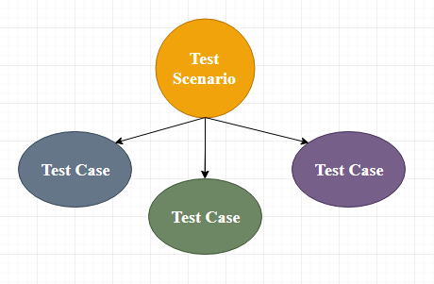
Test Case
The test case is defined as a group of conditions under which a tester determines whether a software application is working as per the customer's requirements or not.
Test case designing includes preconditions, case name, input conditions, and expected result.
A test case is a first level action and derived from test scenarios.

Slide 99
Test Case
It is an in-details document that contains all possible inputs (positive as well as negative) and the navigation steps, which are used for the test execution process.
Writing of test cases is a one-time attempt that can be used in the future at the time of regression testing.
Test case gives detailed information about testing strategy, testing process, preconditions, and expected output.
These are executed during the testing process to check whether the software application is performing the task for that it was developed or not.
Test case helps the tester in defect reporting by linking defect with test case ID.
Detailed test case documentation works as a full proof guard for the testing team because if developer missed something, then it can be caught during execution of these full-proof test cases.
To write the test case, we must have the requirements to derive the inputs, and the test scenarios must be written so that we do not miss out on any features for testing.
Then we should have the test case template to maintain the uniformity, or every test engineer follows the same approach to prepare the test document.

Slide 100
When do we write a test case?
When the customer gives the business needs then, the developer starts developing and says that they need 3.5 months to build this product.
And In the meantime, the testing team will start writing the test cases.
Once it is done, it will send it to the Test Lead for the review process.
And when the developers finish developing the product, it is handed over to the testing team.
Note: When writing the test case, the actual result should never be written as the product is still being in the development process. That is why the actual result should be written only after the execution of the test cases.

Slide 101
Why we write the test cases?
To require consistency in the test case execution: we will see the test case and start testing the application.
To make sure a better test coverage: for this, we should cover all possible scenarios and document it, so that we need not remember all the scenarios again and again.
It depends on the process rather than on a person: A test engineer has tested an application during the first release, second release, and left the company at the time of third release. As the test engineer understood a module and tested the application thoroughly by deriving many values. If the person is not there for the third release, it becomes difficult for the new person. Hence all the derived values are documented so that it can be used in the future.
To avoid giving training for every new test engineer on the product: When the test engineer leaves, he/she leaves with a lot of knowledge and scenarios. Those scenarios should be documented so that the new test engineer can test with the given scenarios and also can write the new scenarios.
Note: when the developers are developing the first product for the First release, the test engineer writes the test cases. And in the second release, when the new features are added, the test engineer writes the test cases for that also, and in the next release, when the elements are modified, the test engineer will change the test cases or writes the new test cases as well.

Slide 102
Typical Test Case Parameters:
Test Case ID
Test Scenario
Test Case Description
Test Steps
Prerequisite
Test Data
Expected Result
Test Parameters
Actual Result
Environment Information
Comments

Slide 103
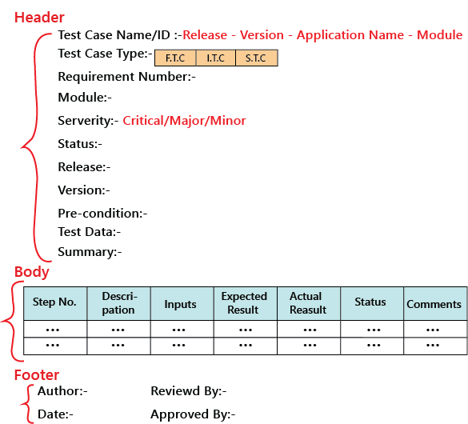
Test Case Template

Slide 104
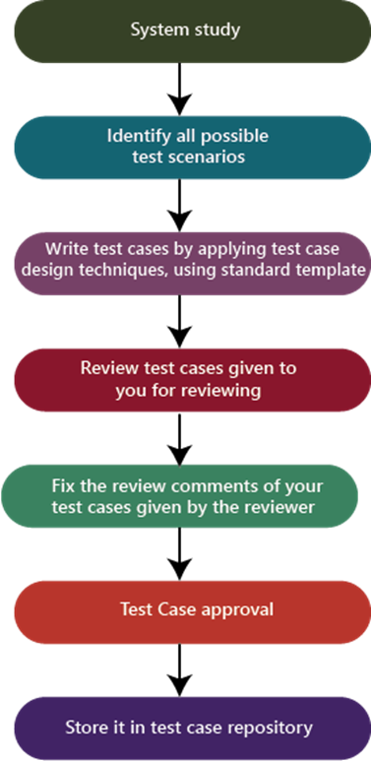
Process to write test cases

Slide 105
Process to write test cases
System study
Understand the application by looking at the requirements or the SRS, which is given by the customer.
Identify all scenarios
When the product is launched, what are the possible ways the end-user may use the software to identify all the possible ways.
I have documented all possible scenarios in a document, which is called test design/high-level design.
The test design is a record having all the possible scenarios.
Write test cases
Convert all the identified scenarios to test claims and group the scenarios related to their features, prioritize the module, and write test cases by applying test case design techniques and use the standard test case template, which means that the one which is decided for the project.
Review the test cases
Review the test case by giving it to the head of the team and, after that, fix the review feedback given by the reviewer.

Slide 106
Process to write test cases
Test case approval
After fixing the test case based on the feedback, send it again for the approval.
Store in the test case repository
After the approval of the particular test case, store in the familiar place that is known as the test case repository.

Slide 107
Defect in Software Testing
When a test engineer tests a piece of code, he/she comes across differences in expected output to the existing output, which is known as a defect.
Substitute of defect can be further known as issues, bugs, and incidents in software testing.
Test engineercan identify the defect, and it was fixed by the developer in the development phase of the software development life cycle.

Slide 108
Examples of Defects
User gives wrong / incomplete requirements
Analyst interprets requirement incorrectly
Requirements are not recorded correctly
Incorrect design specs
Incorrect program specs
Errors in coding
Data entry errors
Errors in testing: falsely detect an error / fail to detect existing errors
Mistakes in error correction

Slide 109






Defect Life Cycle
New
Yes
Opened
Assign/Reassigned
No
No
Fixed
Retested
Closed

Slide 110
Defect Attributes
DefectId – A unique identifier of the defect.
Summary – A one-line summary of the defect, more like a defect title.
Description – A detailed description of the defect.
Build Version – Version of the build or release in which defect is found.
Steps to reproduce – The steps to reproduce the defect.
Expected Behavior – The expected behavior from which the application is deviating because of the defect.
Actual Behavior – The current erroneous state of the application w.r.t. the defect.
Priority – Based on the urgency of the defect, this field can be set on a scale of P0 to P3.
Severity – Based on the criticality of the defect, this field can be set to minor, medium, major or show stopper.
Reported By – Name of the QA, reporting the defect.
Reported On – The date on which the defect was raised.
Assigned To – The person to whom the defect is assigned in its current state. It can be the developer fixing the defect, the QA for verification of the fixed defect or the manager approving the defect.
Current Status – The current status of the defect (one of the states of the defect life cycle).
Environment – The environment in which the defect is found – release, staging, production, etc.

Slide 111
Defect Reporting
To have a complete record of discrepancies that may
be used in multiple ways
Forms basis for quality measurement
Major purpose
Correct the defect
Report status of application
Gather statistics to predict defects in future applications
Process improvement

Slide 112
Defect Tracking Tools
Quality Center
Rational Clear Quest
Bugzila
Excel Sheet

Slide 113
What is Defect Management Process?
The Defect Management Process is process where most of the organizations manage the Defect Discovery, Defect Removal, and then the Process Improvement.
As the name recommends, the Defect Management Process (DMP) manages defects by purely detecting and resolving or fixing the faults.
It is impossible to make a software 100% error or defect-free, but several defects can be declined by fixing or resolving them.
The defect management process primarily focuses on stopping defects, finding defects in the earlier stages, and moderating the effect of defects.

Slide 114
Objective of Defect Management Process (DMP)
The primary objective of DMP is to expose the defects at an early stage of the software development process.
The execution of the defect management process will help us enhance the process and implementation of software.
The defect management process reduces the impact or effects of defects on software.
The Defect management process (DMP) helps us to avoid defects.
The main goal of the Defect management process is to resolve or fixing the defects.
For the different organization or projects the critical goals of the Defect management process is as follows:
The defect management process allows us to provide input for status and progress reports about the defect.
To find the primary cause that how the defect happened and how to handle it.
To provide input, for information related to the release of the defect.

Slide 115
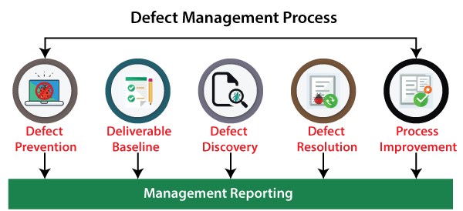
Various Stages of Defect Management Process
Defect Prevention
Deliverable Baseline
Defect Discovery
Defect Resolution
Process Improvement
Management Reporting

Slide 116
1. Defect Prevention
Execution of procedures, methodology, and standard approaches decreases the risk of defects.
Defect removal at the initial phase is the best approach in order to reduction its impact.
Because in the initial phase of fixing or resolving defects is less expensive, and the impact can also be diminished.
But for the future phases, identifying faults and then fixing it is an expensive process, and the effects of defect can also be amplified.
The defect prevention stage includes the following significant steps:
Estimate Predictable Impact
If the risk is encountered, then we can calculate the estimated financial impact for every critical occasion.
Minimize expected impact
When all the critical risk has been discovered, we can take the topmost risks that may be dangerous to the system if encountered and try to diminish or eliminate it.
Those risks that cannot be removed will decrease the possibility of existence and its financial impact.
Identify Critical Risk
Identify the system's critical risks that will affect more if they happened throughout the testing or in the future stage.

Slide 117
2. Deliverable Baseline
The second stage of the defect management process is the Deliverable baseline. Here, the deliverable defines the system, documents, or product.
We can say that the deliverable is a baseline as soon as a deliverable reaches its pre-defined milestone.
In this stage, the deliverable is carried from one step to another; the system's existing defects also move forward to the next step or a milestone.
In other words, we can say that once a deliverable is baselined, any additional changes are controlled.

Slide 118
3. Defect Discovery
At the early stage of the defect management process, defect discovery is very significant. And later, it might cause greater damage.
If developers have approved or documented the defect as a valid one, then only a defect is considered as discovered.
As we understood that, it is practically impossible to eliminate each defect from the system and make a system defect-free. But we can detect the defects early before they become expensive to the project.
The following phases have been including in the defect discovery stage; let's understand them in details:
Identify a defect
Find the defects before becoming a critical problem.
Report a defect
The moment testing team identifies a defect, they need to assign known issues to the development team for further evaluation and fixing process.
Acknowledge Defect
Once the test engineers' hand over the defect to the assigned developers, now it is the responsibility of development teams to acknowledge the fault and remain further to fix it if the defect is a valid one.

Slide 119
4. Defect Resolution
The Defect Resolution is a step-by-step procedure of fixing the defects, or we can say that this process is beneficial in order to specified and track the defects.
This process begins with handing over the defects to the development team. The developers need to proceed with the resolution of the defect and fixed them based on the priority.
Once the defect has been selected, the developer sends a defect report of resolution to the test manager's testing team.
The defect resolution process also involves the notification back to the test engineer to confirm that the resolution is verified.

Slide 120
4. Defect Resolution
We need to follow the below steps in order to accomplish the defect resolution stage.
Prioritize the risk
The development team evaluates the defects and arranges the fault's fixing.
If a defect is more impactful on the system, then developers need to fix those defects on a high priority.
Fix the defect
Developer will fix the defects as per the priority, which implies that the higher priority defects are resolved first. Then the developer will fix the lower priority defects.
Report the Resolution
Developer needs to send the fixed defects report. As it is the responsibility of development teams to make sure that the testing team is well aware of when the defects are going to be fixed and how the fault has been fixed.

Slide 121
5. Process Improvement
In the process improvement phase, we will look into the lower priority defects because these defects are also essential as well as impact the system.
All the acknowledged defects are equal to a critical defect from the process improvement phase perspective and need to be fixed.
The people involved in this particular stage need to recall and check from where the defect was initiated.
Depending on that, we can make modifications in the validation process, base-lining document, review process that may find the flaws early in the process, and make the process less costly.
These minor defects allow us to learn how we can enhance the process and avoid the existence of any kind of defects that may affect the system or the product failure in the future.

Slide 122
6. Management Reporting
Evaluation and reporting of defect information support organization and risk management, process improvement, and project management.
The information collected on specific defects by the project teams is the root of the management reporting. Therefore, every organization needs to consider the information gathered throughout the defect management process and the grouping of individual defects.

Slide 123
Defect Workflow and States
Various organizations that achieve the software testing with the help of a tool that keeps track of the defects during the bug/defect lifecycle and also contains defect reports.
Generally, one owner of the defects reports at each state of defect lifecycle, responsible for finishing a task that would move defect report to the successive state.
Sometimes, defect report may not have an owner in the last phases of the defect lifecycle if we may face the following situation:
If the defect is invalid, then the Defect report is cancelled.
The defect report is considered deferred if the defect won't be fixed as part of the project.
If the fault cannot be detected anymore, hence defect report is regarded as not reproducible.
The defect report is considered closed if the defect has been fixed and tested.

Slide 124
Defect States
If defects are identified throughout the testing, the testing team must manage them in the following three states:
Initial state
also known as open state.
One or several test engineers are responsible for collecting all required data to fix the defects in this state.
Returned state
The person receiving the test report rejects and asks the report creator to provide further information.
In a returned state, the test engineers can provide more information or accept the rejection of the report.
If various reports are rejected, the test manager should look out for faults in the initial information collection process itself.
The returned state is also referred as the clarification state or rejected state.

Slide 125
Defect States
Confirmation state
Test engineer performed a confirmation testingto make sure that the defect has been fixed.
It is achieved by repeating the steps, which found the defect at the time of testing.
If the defect is resolved, then the report is closed.
And if the defect was not resolved, then the report is considered as re-opened and reported back to the owner who formerly preserved the defect report for fixing.
A confirmation state is also known as a verified or resolved state.

Slide 126
Case Study 1
The following are the defects
The month list does not allow store manager to select the month for producing top ten list report
The reason for blocking a customer is not mandatory
The overdue alert is missing
The report of rental pattern is not formatted properly in terms of alignment.
The overdue calculated is up to 3 decimal places

Slide 127
Case Study 1
After adding movies to stock beyond 20, the stock quantity remains unchanged.
System removes users from the users list when deleted, but form the database.
The report of rental patterns should be displayed in the form of line graph.
System crashes when order is placed on movie from other office.
Back up does not provides facility to choose another location, uses default.
You have to generate a defect report as per the given format.

Slide 128
Case Study 2
Causes and cost of defect
Requirements ambiguous, not defined | 32 | Rs 8000
Design incorrect | 13 | Rs5000
Coding errors | 45 | Rs 4000
Miscellaneous | 10 | Rs 2500

Slide 129
Case Study -2
Number of defects with following severity levels
Critical – 12
High – 25
Medium – 22
Low - 41
The Number of defects identified at each stage
Verification - 10
Validation – 100
Customer site – 15
The development team resolved all critical and high severity defects before delivery.
You are expected to analyze and report findings

Slide 130
Environment
Development – It is an environment where developers commit code, experiments, fix bugs, make mistakes etc…
Staging – It is an environment where manual or automated tests are executed, and due to complexity, these can consume a lot of server resources.
Production – It is an environment where we create value for customers and/or the business. This is a highly sensitive environment and puts a deep effect on your reputation and brand name.

Slide 131
Why don’t we need all of these happening in the same environment?
The main reason is that you never want to mix testing and production environment because development involves a lot of debugging and testing. One incorrect program can spoil the server’s memory, CPU cores, Disk I/O and “hang” it.
While administering quality assurance, unit tests, and stress testing, you need to make sure they are executed in a totally segregated environment. If something explodes in a development environment or in QA, it will adversely affect the production environment and thus live users and their mission-critical data!
Having server for dev, test and production mean shared resources between dev, test, and production – shared database, shared disk space, shared disk I/O, shared CPUs, shared network bandwidth and unwanted stress.
We don’t want the business to grind to a halt because a new build has pushed to your servers it has started swapping on hard-drives and are consuming every core on the processor.
We don’t want to bring down the server uptime SLA percentage due to unplanned system configuration and architectural errors.

Slide 132
What is a Test Plan?
Test planning, the most important activity to ensure that there is initially a list of tasks and milestones in a baseline plan to track the progress of the project. It also defines the size of the test effort.
It is the main document often called as master test plan or a project test plan and usually developed during the early phase of the project.

Slide 133
Test Plan Identifiers:
S.No | Parameter | Description
1 | Test Plan Identifier | Unique identifying reference.
2 | Introduction | A brief introduction about the project and to the document.
3. | Test items | A test item is a software item that is the application under test
4. | Features to be tested | A feature that needs to tested on the testware.
5. | Features not to be tested | Identify the features and the reasons for not including as part of testing.
6. | Approach | Details about the overall approach to testing.
7. | Item pass/fail criteria | Documented whether a software item has passed or failed its test.
8. | Test deliverables | The deliverables that are delivered as part of the testing process,such as test plans, test specifications and test summary reports.
9. | Testing tasks | All tasks for planning and executing the testing.

Slide 134
Test Plan Identifiers:
S.No | Parameter | Description
10. | Environmental needs | Defining the environmental requirements such as hardware, software, OS, network configurations, tools required.
11. | Responsibilities | Lists the roles and responsibilities of the team members.
12. | Staffing and training needs | Captures the actual staffing requirements and any specific skills and training requirements.
13. | Schedule | States the important project delivery dates and key milestones.
14. | Risks and Mitigation | High-level project risks and assumptions and a mitigating plan for each identified risk.
15. | Approvals | Captures all approvers of the document, their titles and the sign off date.

Slide 135
Test Planning Activities
To determine the scope and the risks that need to be tested and that are NOT to be tested.
Documenting Test Strategy.
Making sure that the testing activities have been included.
Deciding Entry and Exit criteria.
Evaluating the test estimate.
Planning when and how to test and deciding how the test results will be evaluated, and defining test exit criterion.
The Test artifacts delivered as part of test execution.
Defining the management information, including the metrics required and defect resolution and risk issues.
Ensuring that the test documentation generates repeatable test assets.

Slide 136
Guidelines for Developing Test Plan
Start Early
Keep The Test Plan Flexible
Frequently Review The Test Plan
Keep The Test Plan Concise & Readable
Calculate The Planning Effort
Spend The Time To Do A Complete Test Plan

Slide 137
What is Software Test Estimation?
Test Estimation is a management activity which approximates how long a Task would take to complete.
Estimating effort for the test is one of the major and important tasks in Test Management.
For the success of any project, test estimation and proper execution is equally as important as the development cycle. Sticking to the estimation is very important to build a good reputation with the client.
Experience plays a major role in estimating the “Software Testing Efforts”. Working on varied projects helps us to prepare an accurate estimation of the testing cycle.
Obviously one cannot just blindly put some number of days for any testing task. Test estimation should be realistic and accurate.

Slide 138
Test Estimation Process
“Estimation is the process of finding an estimate, or approximation, which is a value that is usable for some purpose even if input data may be incomplete, uncertain, or unstable.”
We all come across different tasks, duties and deadlines throughout our lives as professionals, now there are two approaches to find the solution to a problem.
The first approach is a reactive approach whereby we try to find a solution to the problem at hand only after it arrives.
In the second approach which can be called a Proactive Approach, we first prepare ourselves well before the problem arrives with our past experiences and then with our past experience, we try to find a solution to the challenge when it arrives.
Estimation can thus be considered as a technique that is applied when we take a proactive approach to the problem.
Thus Estimation can be used to predict how much effort with respect to time and cost would be required to complete a defined task. Once the testing team is able to make an estimate of the problem at hand, then it is easier for them to come up with a solution that would be optimum to the problem at hand.

Slide 139
Basic Pre-requisites
Insights gathered from working with past experience: It is always a good practice to spend some time, recalling past projects which posed challenges similar to the current endeavor at hand.
The available documents or artifacts: The test management repository tools come in handy in these types of scenarios as they store the requirements and clarification documents. These documents can be referred by the testing team to clearly define the scope of the project.
Assumptions about the type of work: Past working experience helps in making assumptions about the project. This is where hiring experienced professionals matters most. Testing managers can pick the brains of these people to deliver the desired results.
Calculation of Potential risks and Threats: The testing team also needs to visualize the potential risks and threats and pitfalls which lie may lie for the team in the future.
Determining whether the documents have been baselined: The testing team also needs to determine if the requirements have been baselined or not. If the documents are not baselined then it is important to determine the frequency of the changes.
All responsibilities and dependencies should be clear: The organization should clearly define the roles and responsibilities for all those who would be performing the estimation process.
Documentation and tracking of the estimation records: All the relevant information to the estimation process should be documented.
Activities to be performed during the test estimation process:
Organize a team that will perform estimations.
Decompose the project into project phases and subsequent constituent activities.
Compute the estimation based on previous projects and professional experience.
Prioritize possible threats and come up with approaches to mitigate those risks.
Review and document the relevant parts of the work.
Submit the work to the relevant stakeholders.

Slide 140
Most Prominent Test Estimation Techniques
Test point estimation
Is a simple and easily understandable estimation technique that is widely used across the software testing spectrum. Iterative phases and simplicity are the most important features of this particular technique.
Work-phase based estimation
Is the estimation technique which is used whereby a guess estimate is made on a particular phase (normally the shortest and simplest of the phases) and then the testing team gradually adds on other phases into the initial estimation and finally comes up with an appropriate estimation.
Use case point estimation
Is the estimation on the use cases where the unadjusted actor weights and unadjusted use case weights are used to determine the software testing estimation.

Slide 141
Test Closure Activities
Test closure activities are those activities which are performed at the end of the testing process. These are usually performed after the product is delivered, like generating test report etc. According to test process, it is essential to guarantee that processes for delivering source information essential for evaluating exit criteria and reporting are available and effective.

Slide 142
Test closure activities, which fall into these four key groups:
Checking for completion of tests
Handing over test objects
Learning Experience
Archiving

Slide 143
Test Completion Report
Test completion reporting is a process where by test metrics are reported in summarised format to update the stakeholders which enables them to take an informed decision.
Test Completion Report Format:
Test Summary Report Identifier
Summary
Variances
Summary Results
Evaluation
Planned vs Actual Efforts
Sign off

Slide 144
Significance of Test Completion Report:
An indication of the quality
Measure outstanding risks
The level of confidence in tested software

